Slide 1
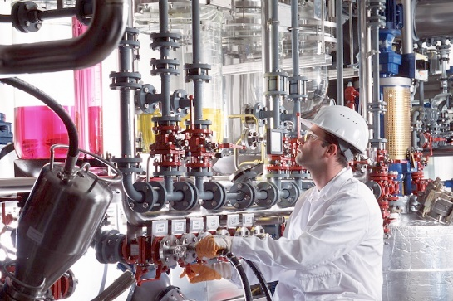
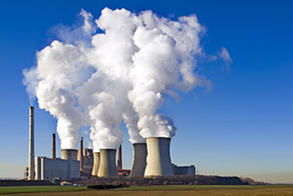
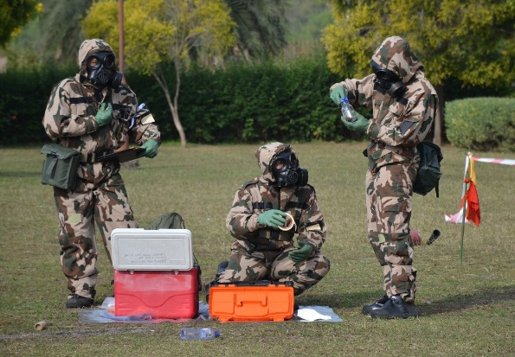
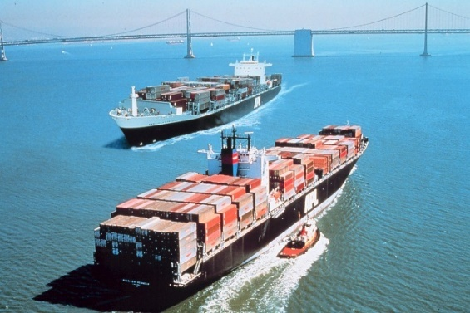
CURRENT STATUS OF CHEMICAL MANAGEMENT IN PAKISTAN
Noman Siraj Director National Authority CWC

Slide 3
AIM
To apprise you about the current status of chemical management in Pakistan
3
Notes:
3

Slide 4
SEQUENCE OF PRESENTATION
What is Chemical Management
Chemical management strategies
National Policy on Chemical Management
Legislative and administrative measures
Chemical safety and security management
Supply Chain Management
Chemical Profiling
Product Stewardship
End User License
4
Notes:
4

Slide 5
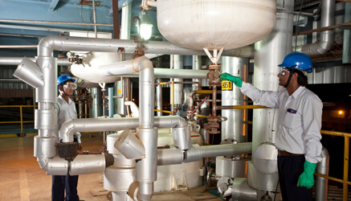
National Policy on Chemical Management Strategies & Components
CHEMICAL MANAGEMENT
Sound ‘chemical management’ means that chemicals are produced and used in such a way to minimize the adverse effects to human health and the environment.

Slide 6
CHEMICAL MANAGEMENT STRATEGIES
Regulatory approaches (e.g., awareness about hazards and how to deal with those, setting standards, imposing bans etc).
Controls on certain chemicals or chemicals uses, establishing reporting requirements.
Non - regulatory approaches (e.g., incentives and voluntary initiatives).
Support by government agencies, industries or trade associations.
Cont…

Slide 7
CHEMICAL MANAGEMENT STRATEGIES
Products containing hazardous substances should all be accompanied by relevant information for users, work-places and at disposal site.
Include a range of preventive strategies, education and awareness-raising and capacity-building.
For all chemicals in commerce, appropriate information detailing their inherent hazards should be made available to the public at no charge and generated where needed with essential health, safety and environmental information made available.

Slide 8
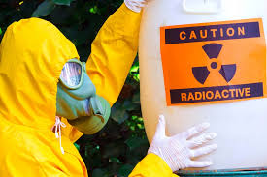
CHEMICAL SAFETY AND SECURITY MANAGEMENT
“Chemical Safety” refers to measures to prevent non-deliberate releases of toxic chemicals into the environment and to mitigate the impact if such events occur. Chemical safety comprises disciplines such as occupational safety, public safety, process safety, environment safety, consumer safety and transport safety.
“Chemical Security” refers to measures to prevent deliberate releases of toxic chemicals and to mitigate the impact if such events occur. In a wider context, it also includes policies to prevent attempts to acquire toxic chemicals or chemical weapons precursors.

Slide 9
PAKISTAN’S POLICY
Consistently supports all OPCW international and regional
initiatives.
Consistently supports the cause of global chemical
disarmament, as part of its overall security policy.
Supports effective legal controls on export, transit and
trans - shipment of chemical warfare related equipment, material
and technologies.
Regulates the use of chemicals only for peaceful purposes.

Slide 10
NATIONAL POLICY ON CHEMICAL
MANAGEMENT – STRATEGIES & COMPONENTS
In Pakistan, a well structured mechanism exists for the management of chemicals which aims at:
Awareness within all sectors of society of the risks associated with chemicals;
Prevention i.e., taking steps to avoid or minimize chemical pollution, contamination, accidents, and poisonings;
Control and Management of chemicals which present risks to health and the environment resulting from extraction, manufacture, use, handling, transport, storage and disposal of chemicals. This includes emergency preparedness and response capabilities in the event of an accident.
Cont…

Slide 11
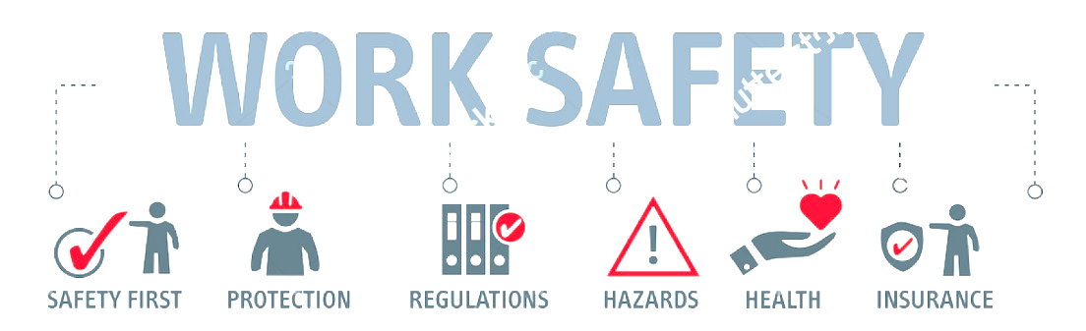
NATIONAL POLICY ON CHEMICAL
MANAGEMENT – STRATEGIES & COMPONENTS
Comprehensive legislation.
Rules, regulations, acts and standards.
Non regulatory mechanisms.
Certifications (ISO 14001 for Environmental Management System, OHSAS (Occupational Health and Safety Assessment Series) and OHSMS (Occupational Health and Safety Management System).

Slide 12
LEGAL FRAMEWORK FOR MANAGEMENT OF CHEMICALS
A comprehensive and dedicated legislative framework is essential for the sound management of chemicals. There are 53 Acts and regulations, which are considered relevant for the management of chemicals in Pakistan.

Slide 13
LEGISLATIVE / REGULATORY APPROACHES
Notification requirements.
Pre-marketing review of toxicity; registration; and licensing for manufacture, possession and sale.
Controls on importation and exportation under Export Control Regime.
Controls on hazardous installations.
Occupational health and safety controls.
Controls on transportation of hazardous good.
Minimization and disposal of hazardous wastes.
Control on use.

Slide 14
LEGISLATIVE AND ADMINISTRATIVE MEASURES
Explosives Act 1884.
The Agricultural Pesticides Ordinance 1971 & Rules 1973.
The Railway Act 1980.
Environmental Protection Act 1997.
Hazardous Materials Act 1997 & Rules – 2007.
Anti-Terrorism Act of 1997 (prohibits malicious activities using
chemicals and other materials. It also makes the facilitation of such
activities as punishable).
Cont…

Slide 15
LEGISLATIVE AND ADMINISTRATIVE MEASURES
CWC Implementation Presidential Ordinance of 2000.
The Punjab, NWFP, Sindh and Balochistan Local Government
Ordinance 2001.
Export Control Act of 2004.
Labour Policy 2006.
Statutory Regulatory Order 2010.
Import and Export Policy Order 2013.
Trade Policy Procedure Order of 2016.
Drug Regulatory Act.

Slide 16
MINISTRIES, AGENCIES & OTHER INSTITUTIONS MANAGING CHEMICALS
Ministry of Finance
Ministry of Commerce
Ministry of Industries & Production
Ministry of Health
Ministry of Environment
Ministry of Climate Change
Ministry of Science and Technology
Ministry of Defence

Slide 17
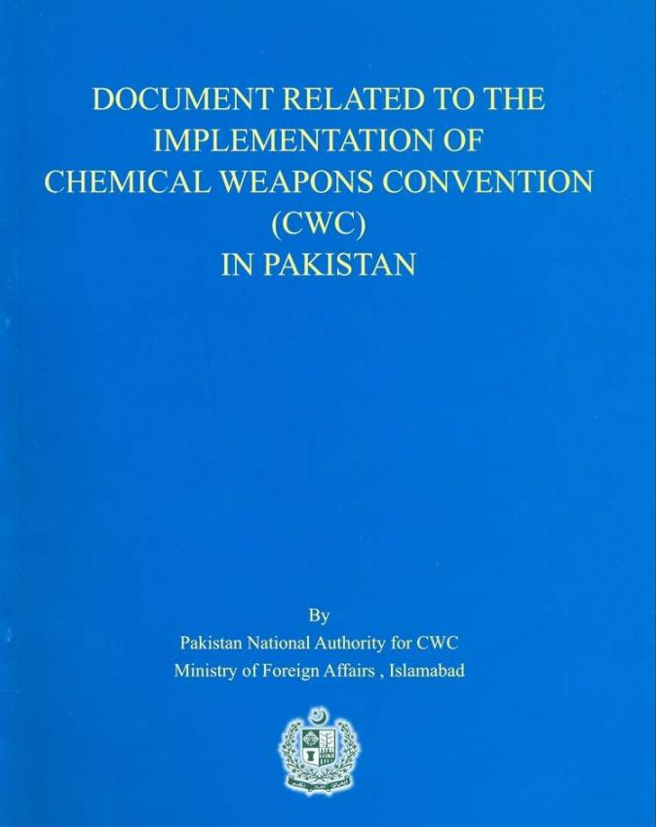
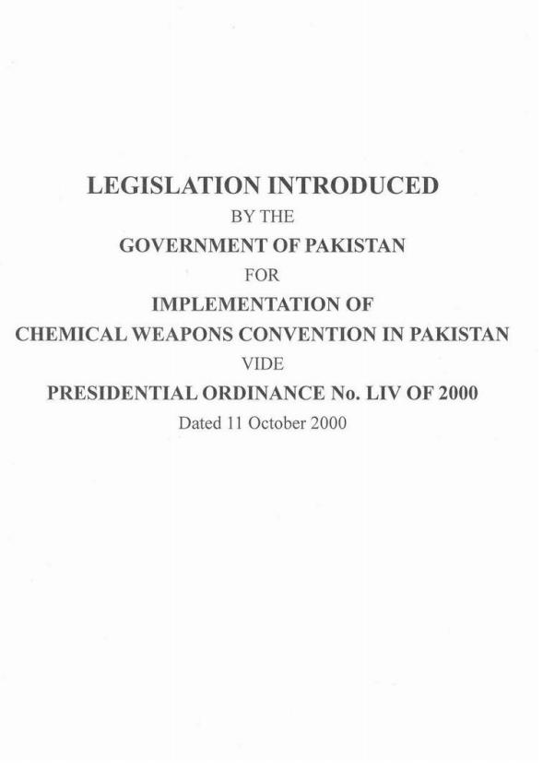
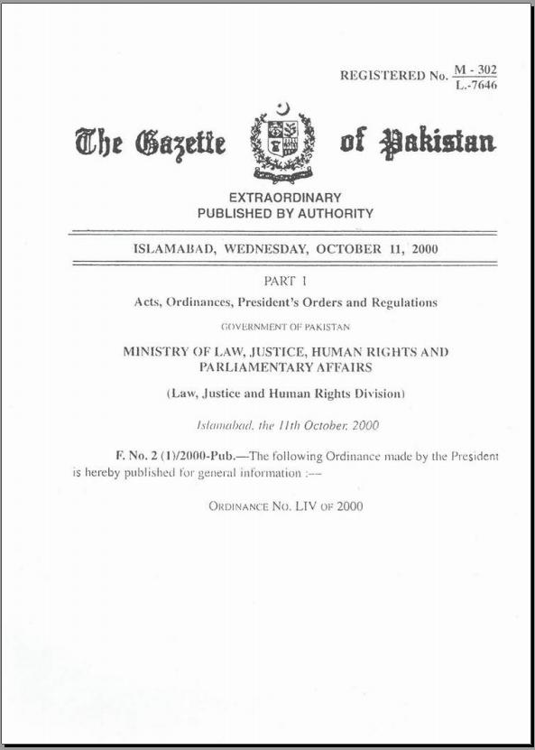
Presidential Ordinance 2000
CWC IMPLEMENTATION ORDINANCE, 2000

Slide 18
CWC IMPLEMENTATION ORDINANCE, 2000
The Presidential Ordinance 2000 is a dedicated Act and gives effect to Pakistan’s obligations, responsibilities and rights as a State Party to the CWC.
It is a comprehensive legislation and its scope effectively covers all the national obligations under the CWC such as prohibitions of all kind as specified in the Convention; penal provisions; extraterritorial applications; declaration obligations; and regime for Schedule I, II and III chemicals, such as regulation, licensing, import / export controls, inspections, access to facility, samples, inspectors’ privileges / immunities, confidentiality aspects, mandate and enforcement powers of National Authority.

Slide 19
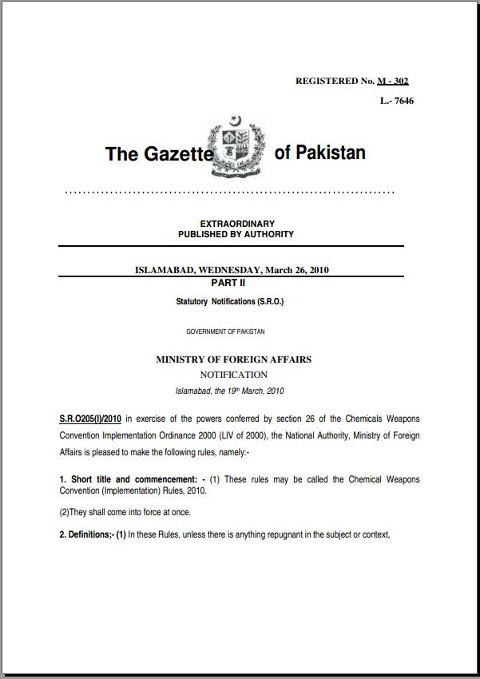
S.R.O 2010
STATUTORY NOTIFICATION (SRO), 2010

Slide 20
STATUTORY NOTIFICATION (SRO), 2010
Pakistan takes positive steps for preventing private individuals and non-governmental entities from engaging in prohibited activities. Those who violate these provisions can be imprisoned for a term which may extend up to 25 years.
Pakistan’s administrative measure such as the CWC Implementation Rules - 2010 is also a dedicated instrument, which effectively prevents and redresses any breach of the CWC.

Slide 21
STATUTORY NOTIFICATION (SRO), 2010
In exercise of powers conferred by Ordinance 2000, these rules have been formulated. Salient features of SRO are:-
Establishment / functions of Advisory Committee.
Registration requirement and criteria.
Record keeping requirement.by the facility.
Declaration requirement of the facility.
Inspection procedures.
Establishment of Emergency Coordination Cell.
Offences related to inspections, disclosure or registration.
Offences and penalties.

Slide 22
SUPPLY CHAIN MANAGEMENT
Supply Chain Management is primarily concerned with the efficient integration of suppliers, factories, warehouses and stores so that merchandise is produced and distributed in the right quantities, to the right locations and at the right time. In order to minimize total system cost subject to satisfying customer service requirements.
Points to be kept in mind;
Who is involved
Cost and Service Level
Ensure integration
Ensure Responsible Care (Safety and Environment)
Chemical management designed to implement the measures which can support safe handling of chemicals and reduce the possibility of any incident / accident

Slide 23
SUPPLY CHAIN
Customer
Customer Order Cycle
Retailer
Replenishment Cycle
Distributor
Manufacturing Cycle
Manufacturer
Procurement Cycle
Supplier
Notes:
The supply chain is a concatenation of cycles with each cycle at the interface of two successive stages in the supply chain. Each cycle involves the customer stage placing an order and receiving it after it has been supplied by the supplier stage.
One difference is in size of order. Second difference is in predictability of orders - orders in the procurement cycle are predictable once manufacturing planning has been done.
This is the predominant view for ERP systems. It is a transaction level view and clearly defines each process and its owner.

Slide 24
SUPPLY CHAIN
The supply chain is a concatenation of cycles with each cycle at the interface of two successive stages in the supply chain. Each cycle involves the customer stage placing an order and receiving it after it has been supplied by the supplier stage.
One difference is in size of order. Second difference is in predictability of orders - orders in the procurement cycle are predictable once manufacturing planning has been done.
This is the predominant view for Enterprise Resource Planning (ERP) system. It is a transaction level view and clearly defines each process and its owner.

Slide 25
SUPPLY CHAIN MECHANISM IN PAKISTAN
Preventing any biological, chemical or unauthorized agent to be incorporated into the product.
Preventing any illegal commodity to be intermingled with the shipment.
Preventing transportation assets or a shipment’s contents to be used as a weapon.
Preventing unauthorized access to the product and / or supply chain network.
Preventing disruptions of the supply chain network / infrastructure.
Notes:
Requirements for supply chain security and protection:
To reduce the possibility of any biological or chemical agent to be introduced into the product. While the likely supply chain location for this to occur is as a commodity or in the plant, fresh fruit, vegetables, meat, and seafood could have it occur throughout the supply chain.
To reduce the possibility that illegal commodities such as drugs or explosives are co-mingled with food shipments. While the food itself may not be directly affected, the illegal drug or explosives could injure or kill the firms employees or customers, damage the firm’s reputation, or inhibit the firm’s ability to import product.
To reduce the possibility that the product is replaced by an illegal commodity or person. This could make the firm responsible for importing an illegal item or facilitating the entry of an illegal immigrant.
To reduce the possibility that the load itself could be used as a weapon. While this is not likely in the case of food (unless it was infested with biological hazards), this is a major supply chain consideration for other commodities such as chemicals, petroleum, or other bio-hazards.
25

Slide 26
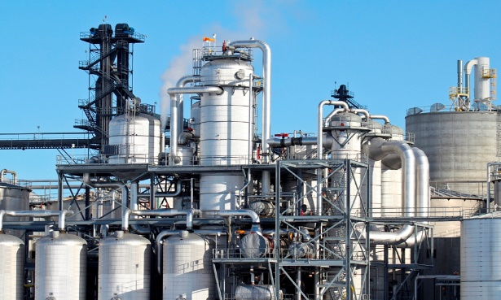
CHEMICAL PROFILING
Chemical profile creates an authoritative document which serves as a basis to strengthen the national system for the management of chemicals throughout their life cycle, meeting the necessary obligations under the Convention.
Chemical Profile update serves as a reference document to identify the gaps that exists and what is needed to bridge the gaps.

Slide 27
PAKISTAN’S CHEMICAL PROFILING MECHANISM
Pakistan has enforced and implements proper chemical profiling which allows its industries to be aware of the hazards posed by the toxicity and volatility of the chemicals.
This Chemical profiling system essentially allows EH&S (HSE or SHE) and business professionals to extract important chemical information out of the materials located in their facility.

Slide 28
PRODUCT STEWARDSHIP
The governmental departments and private industries ensure that whoever designs, produces, sells, or uses a product takes responsibility for minimizing the product’s environmental impact throughout all stages of the products’ life cycle, including end of life management.
Framework legislation should address environmental product design, including source reduction, recyclability and reducing toxicity of products.

Slide 29
PRODUCT STEWARDSHIP IN PAKISTAN
Governance
Government sets goals and performance standards following consultation with stakeholders.
Government allows producers the flexibility to determine the most cost-effective means of achieving the goals and performance standards.
Government is responsible for ensuring a level playing field by enforcing requirements that all producers in a product category participate in a stewardship program.
Product categories required to have stewardship programs are selected using the process and priorities set out in legislation.
Government is responsible for ensuring transparency and accountability of stewardship programs.
Cont…

Slide 30
PRODUCT STEWARDSHIP IN PAKISTAN
Manufacturers are encouraged to reduce use of toxic substances, design to reuse and recycle.
Retailers are encouraged to prefer those manufacturers who offer substantial environmental performance.
Consumers are kept in mind while making / designing a product. Safe, efficient, environment friendly and recyclable products are encouraged for usage.
Environment Protection Agency (EPA) facilitates coordination among local government, industry and NGOs.
Greener design, greener product standard and greener purchasing practices

Slide 31
PERMIT FOR IMPORT AND EXPORT OF SCHEDULE CHEMICALS
In the light of the CWC Implementation Ordinance and CWC Implementation Rules, the National Authority may issue a permit to any facility that intends to export or import Schedule I, II or III chemicals and their mixtures.
For obtaining permit, the importer or exporter shall apply at least forty-five days prior to the intended export or import. For securing the permit, the chemical importing company or exporting company has to fulfill the certain requirements such as providing information on the purpose of import, quantity of imported chemicals, the end uses, name and address of end user(s), certificate that Schedule chemical will not be retransferred, and will be used for not permitted purposes under CWC, etc.

Slide 32
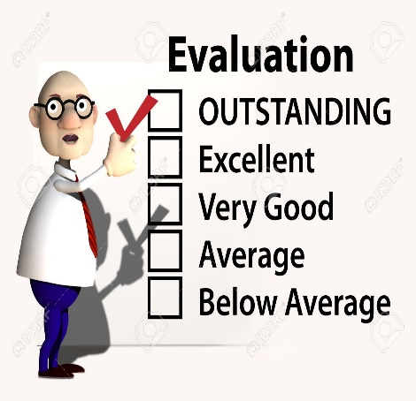
SUPPLIER EVALUATION / AUDIT
Supplier profile
Human rights policy.
Labor standards.
Environment, Health & Safety policy.
Compliance with all applicable laws and regulations.
Protection of Health & Safety of employees & OSHA compliances.
Environmental Compliances.
Chemical handling & storage practices.

Slide 33
CUSTOMER AUDIT –
NO PERMISSION IS GRANTED IF
Customer Identity:
Customer lacking business understanding / instincts.
Customer refuses to give necessary detail.
Customer is not a member of any professional body e.g PCMA.
Business Practices:
Orders are sent at irregular intervals.
Payment is made in Advance (TT via outside, Bank Draft)
An intermediary or agent is named as the consignee.
Use of Products:
Order involve more than one precursor.
Disparity between the USE and DEMAND.
Firms apparently having no use of product ordered.

Slide 34
Pakistan's End-user license
END USER LICENSE
An end-user license agreement (EULA) is a license that gives a user the right to use a chemical while ensuring traceability and maintain a deliberate data base of the chemical use and its lifecycle. The industries have to ensure that they provide the purpose, need and authenticity that the chemical is not being used for any illegal purposes.

Slide 35
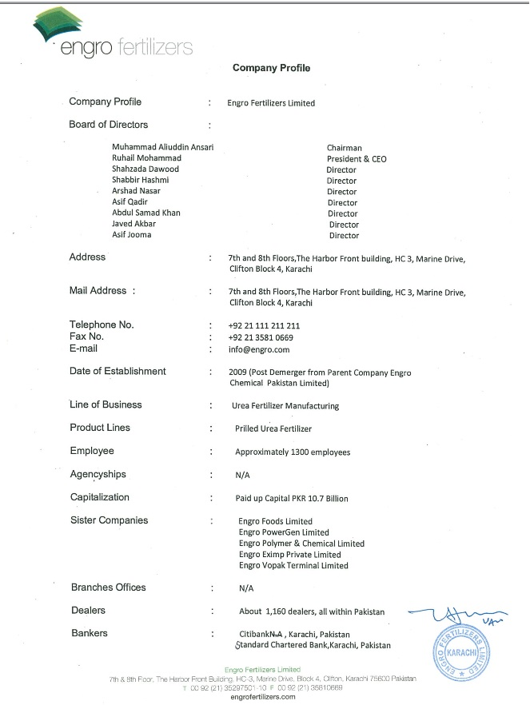
Cont…

Slide 37
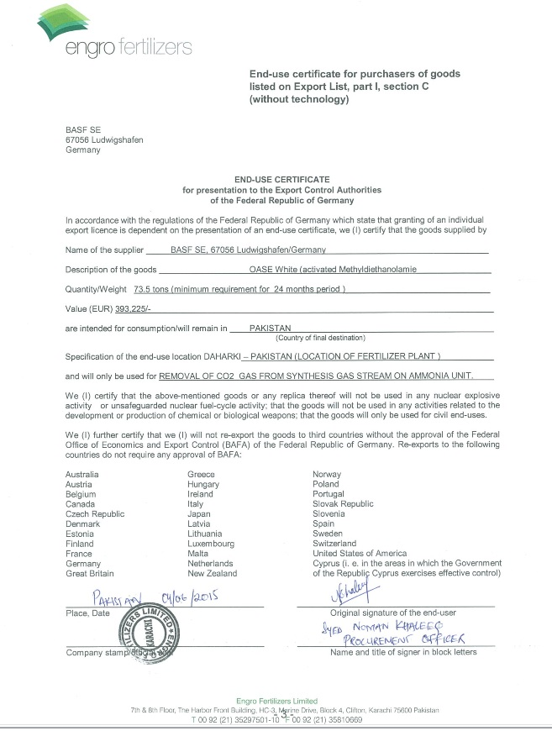

Slide 38
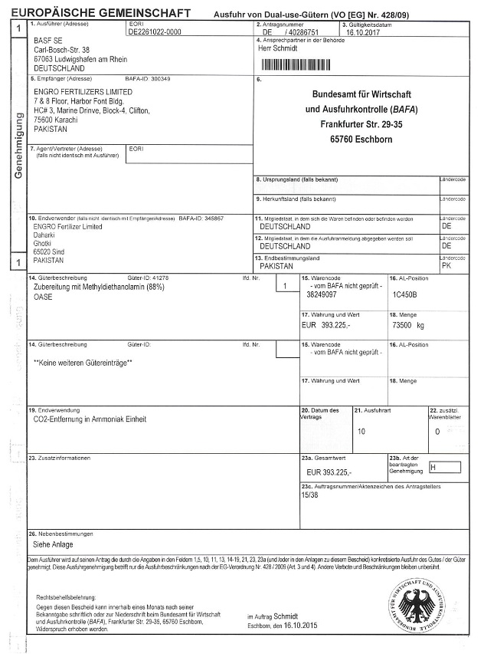
Cont…

Slide 39
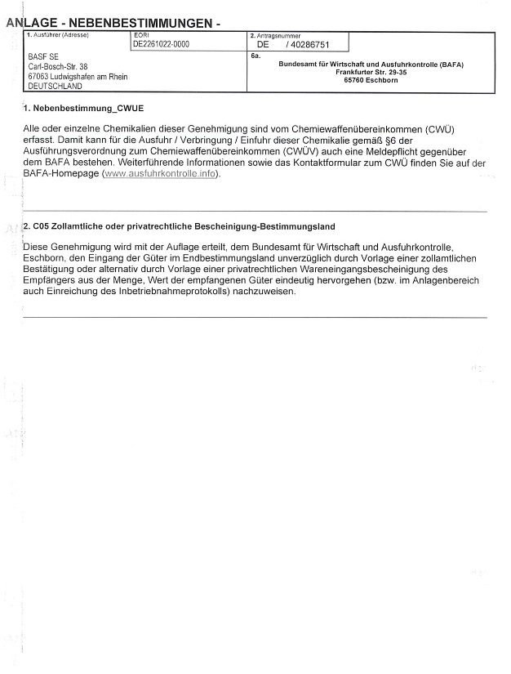

Slide 40
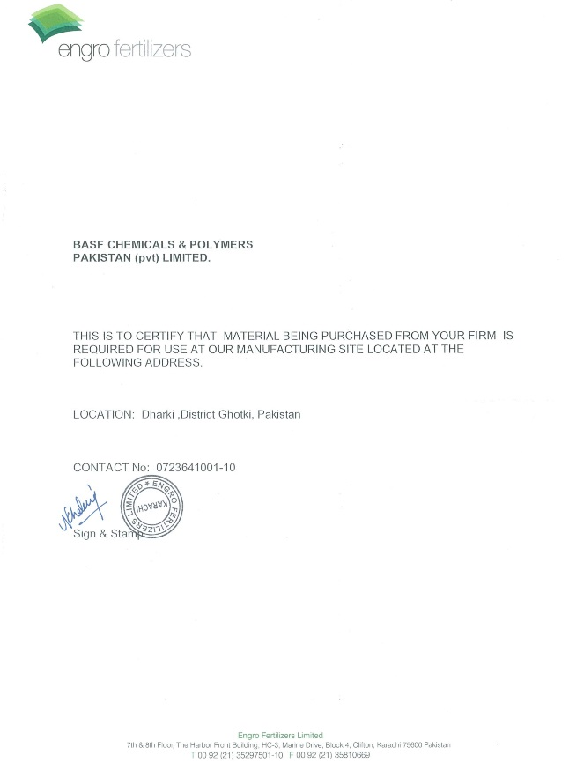

Slide 41
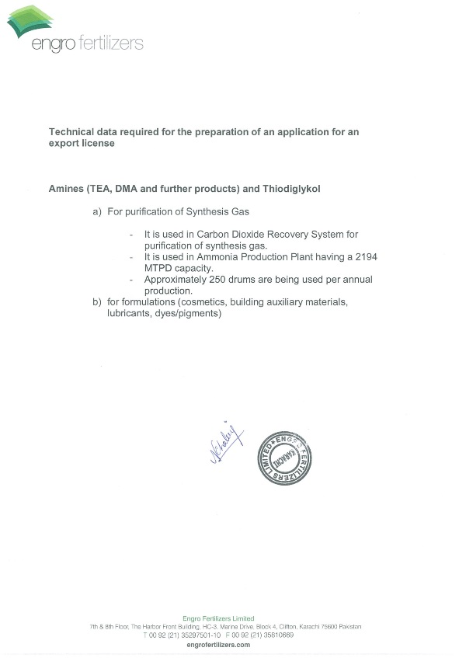

Slide 42
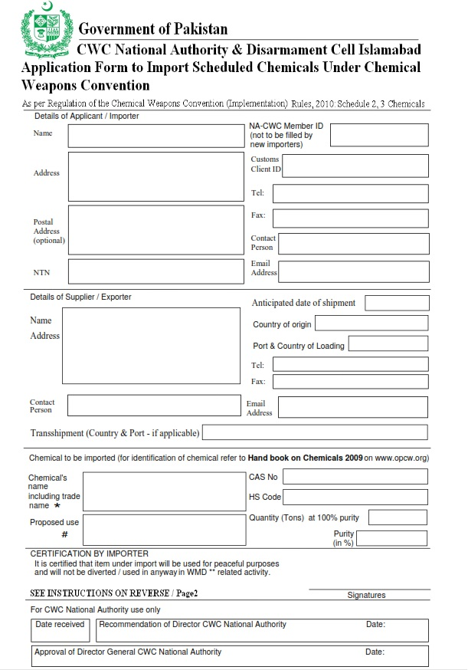
Import Permit Form

Slide 43
PAKISTAN MEMBERSHIP OF
MULTILATERAL AGREEMENTS
Pakistan is State Party to the Chemical Weapons Convention (CWC)
Strategies Approach to International Chemical Management (SAICM).
Basel Convention on the control of trans-boundary movement of hazardous waste and their disposal Commission on Sustainable Development (CSD).
Rotterdam Convention on Prior Informed Consent (PIC) for certain hazardous chemicals and pesticides,
Stockholm Convention on Persistent Organic Pollutants (POPs).
Montreal Protocol on Ozone Depleting Substances.

Slide 44
CONTACT US
+ 92 – 51 – 9207675
+ 92 – 301 – 7734816
+ 92 – 51 – 9207671
na.mofa.pk@hotmail.com
dir.disarmntc@mofa.gov.pk
Director ACDIS – C,
Agha Shahi Block,
Ministry of Foreign Affairs,
G – 5,
Islamabad

Slide 45
THANK YOU

